Slide 1
Azure Software Development Kit (SDK) for .NET
Author: Luis Coco Enríquez

Slide 2
Agenda
Topic
What is Azure SDK for .NET?
How to set up your environment
API Reference
GitHub repositories
C# code samples with Azure SDK for .NET

Slide 3
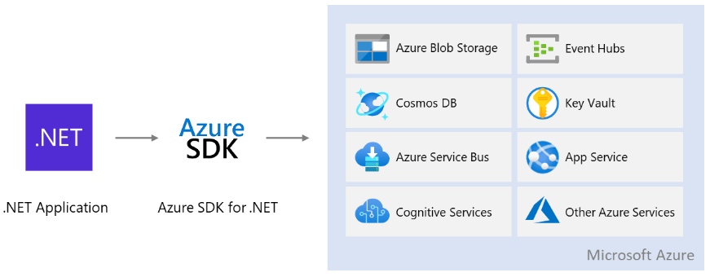
What is Azure SDK for .NET?
Azure SDK libraries allow us to programmatically manage the Azure services from C#
Azure for .NET developers | Microsoft Learn

Slide 4
How to setup your environment
Follow these steps to install and run the Azure SDK for .NET:
1. Create an Azure free account. See video: How to Create a Free Azure Account in Few Minutes
2. Install Azure CLI:
3. Login in Azure account with the command: az login
4. See your Azure account details with the command: az account show
5. Install IDEs with Azure extensions: Visual Studio, VSCode, IntelliJ, Eclipse
6. Install Docker Desktop if you are gong to manage Azure Container Instances or Azure Kubernetes
How to install Azure CLI

Slide 5
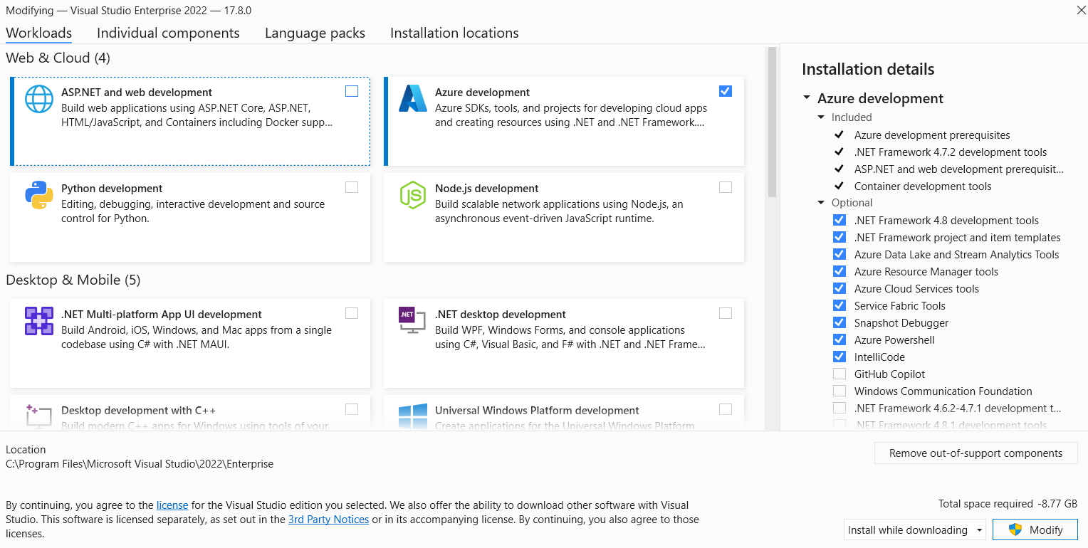
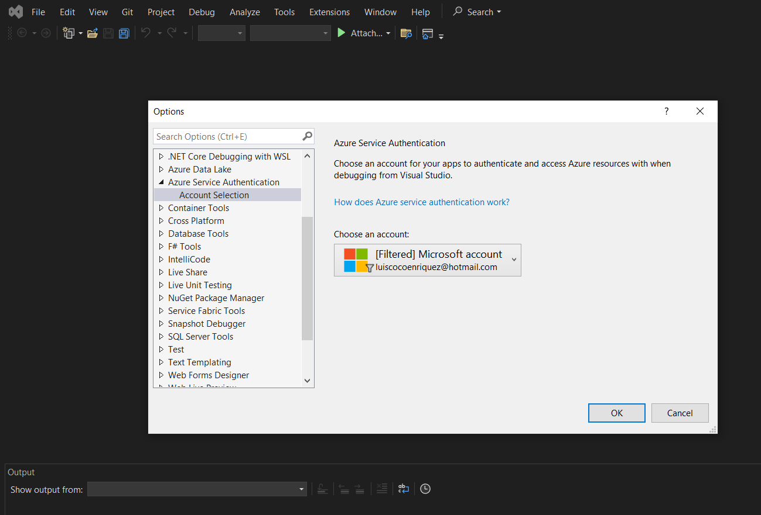
Azure for Visual Studio 2022
https://visualstudio.microsoft.com/vs/community/
https://learn.microsoft.com/en-us/dotnet/azure/configure-visual-studio

Slide 6
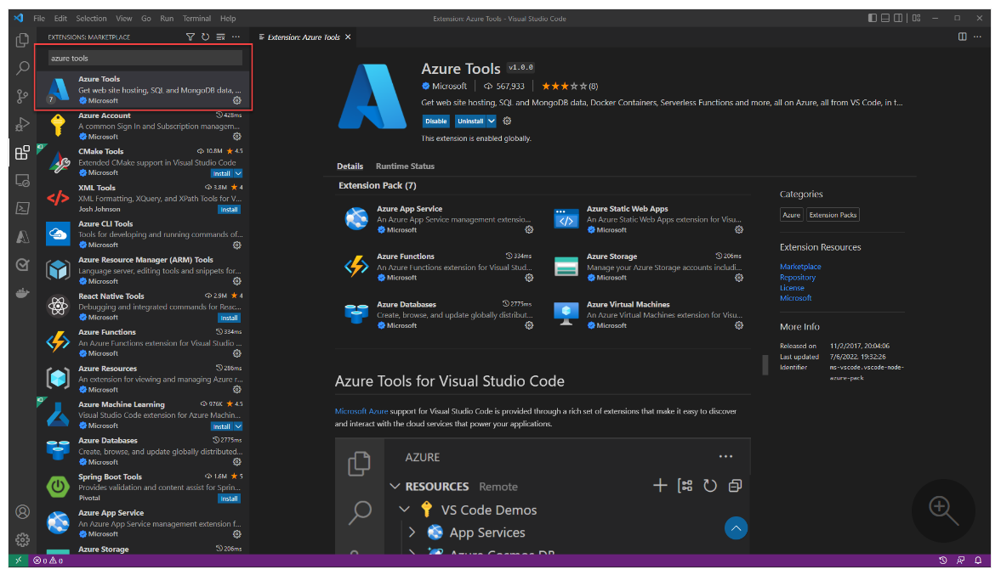
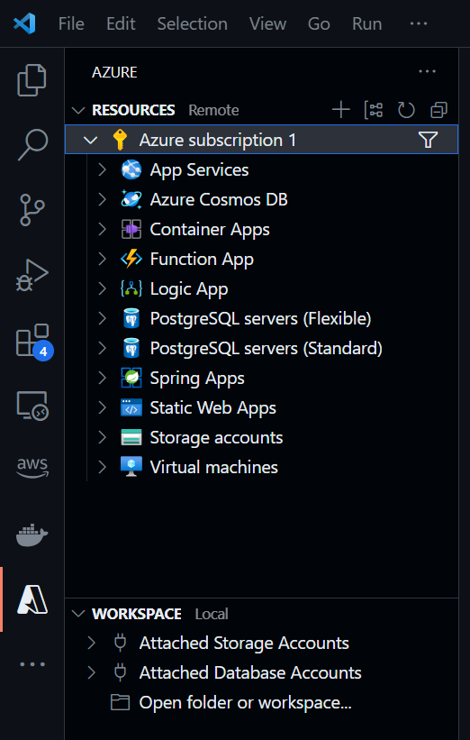
Azure extension for Visual Studio Code
https://learn.microsoft.com/en-us/dotnet/azure/configure-vs-code

Slide 7
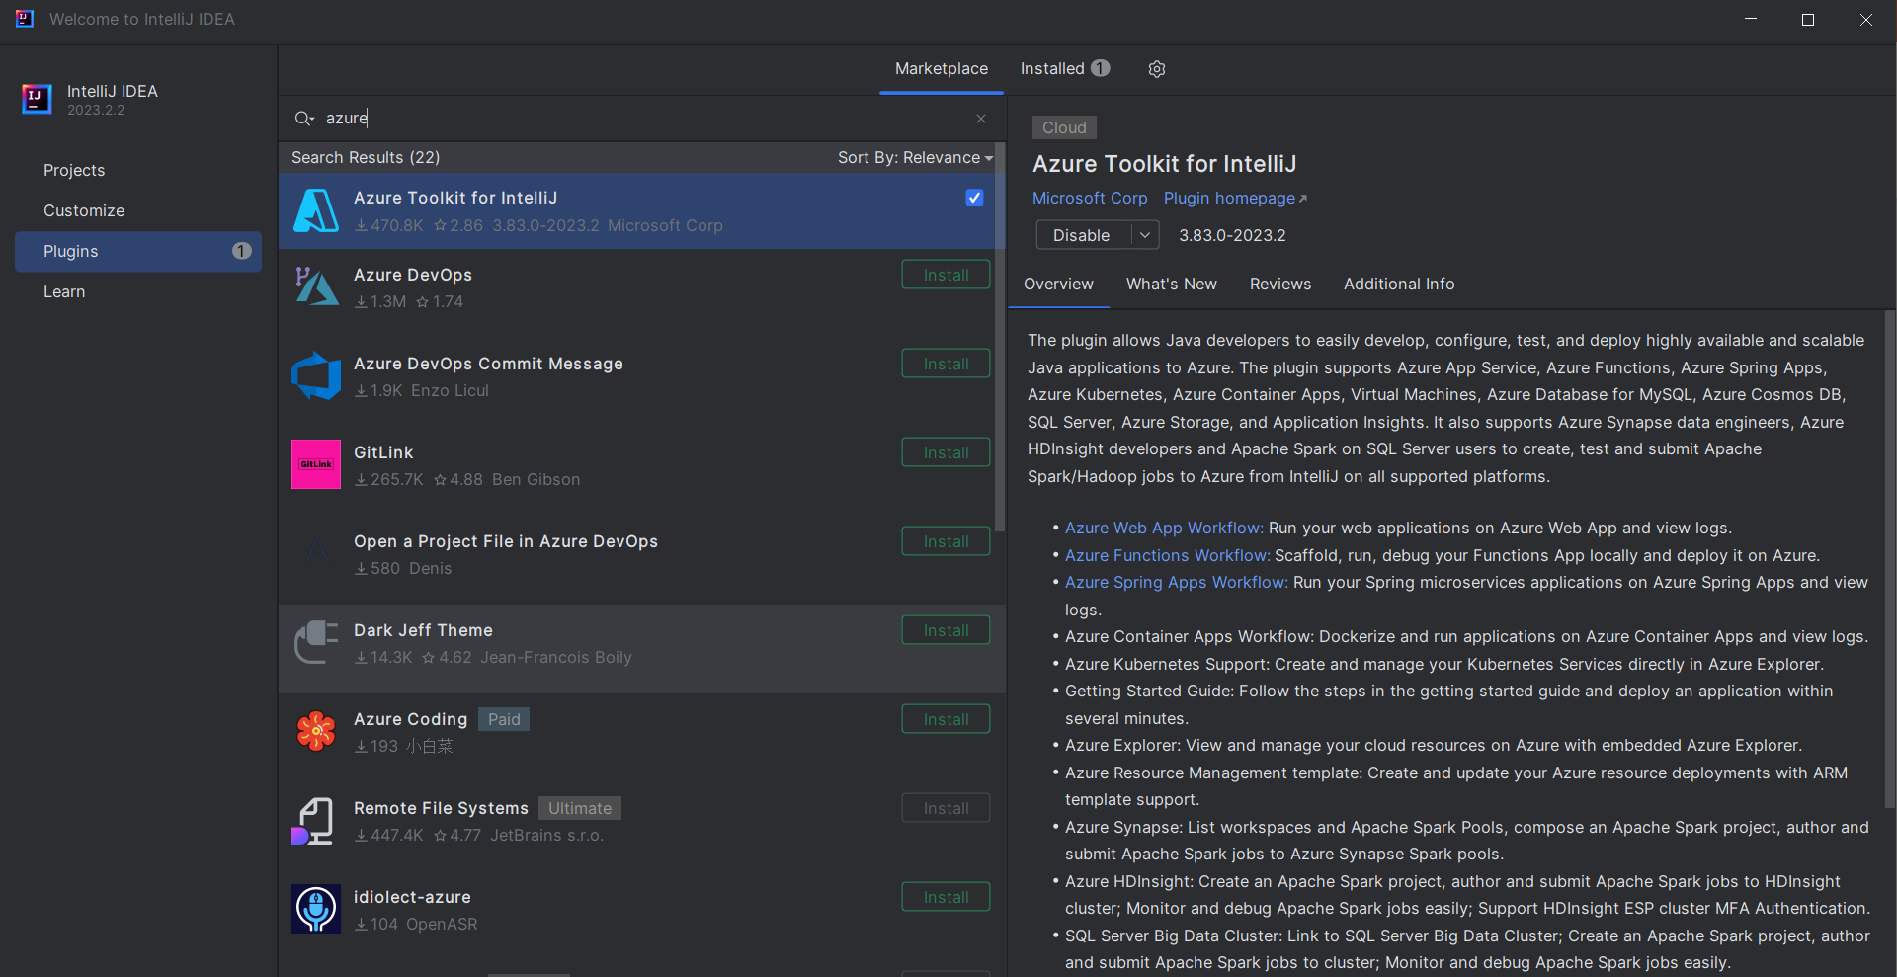
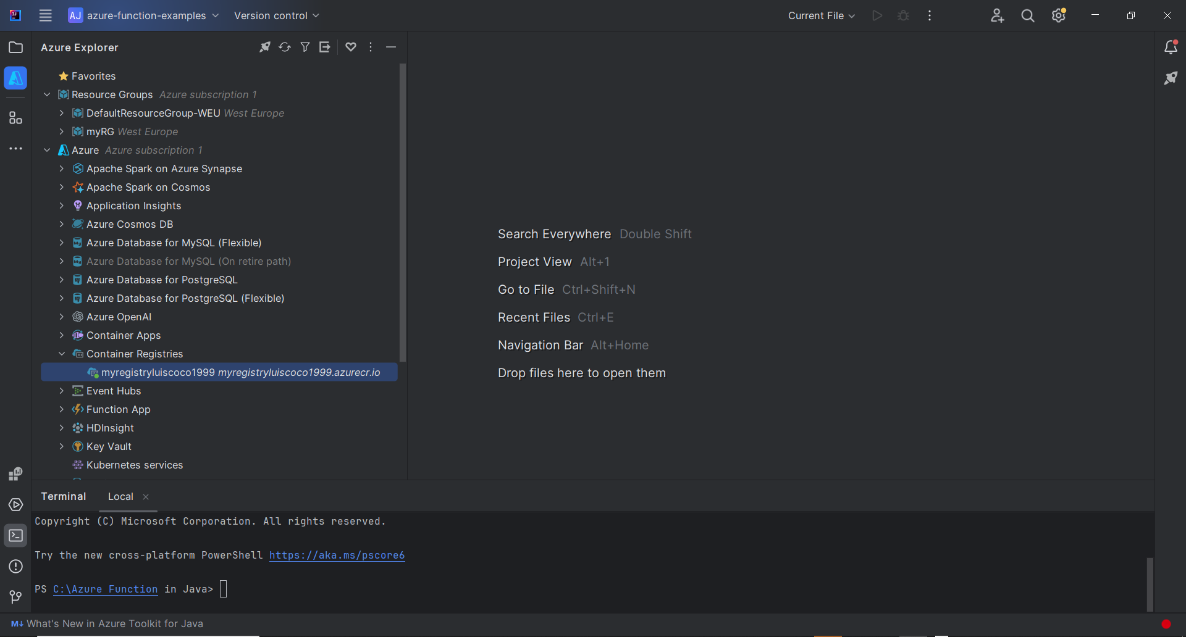
Azure plugin for IntelliJ Community
https://www.jetbrains.com/idea/download/?section=windows

Slide 8
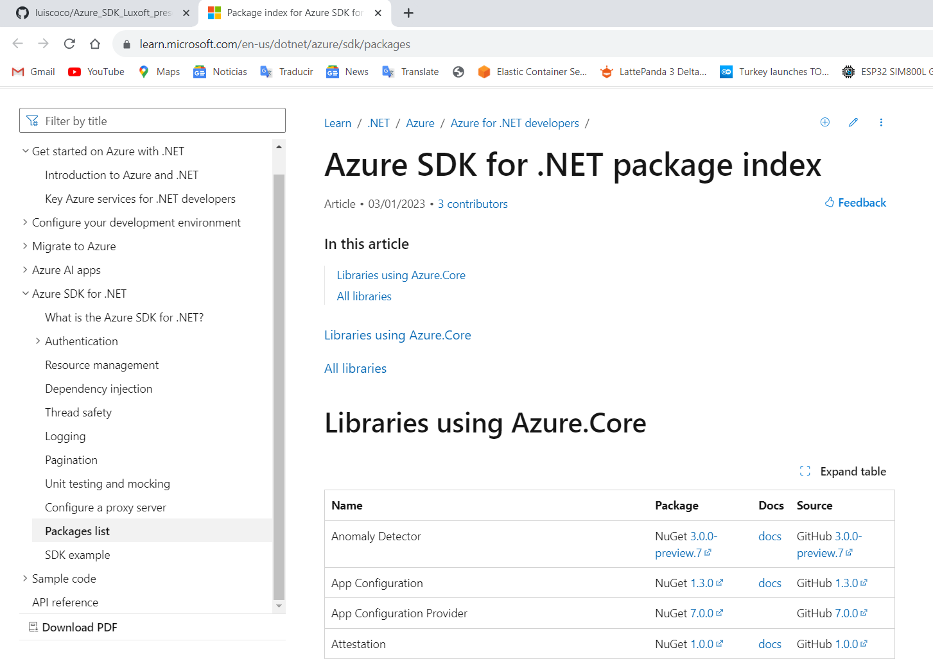
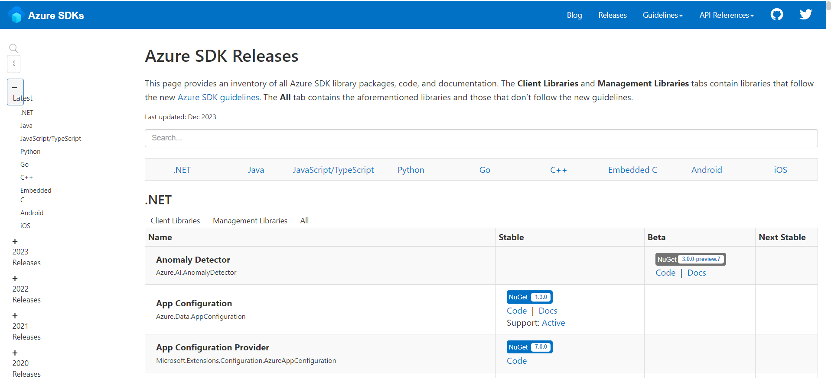
Azure SDK for .NET package index
https://learn.microsoft.com/en-us/dotnet/azure/sdk/packages
Azure SDK releases
https://azure.github.io/azure-sdk/releases/latest/index.html#net

Slide 9
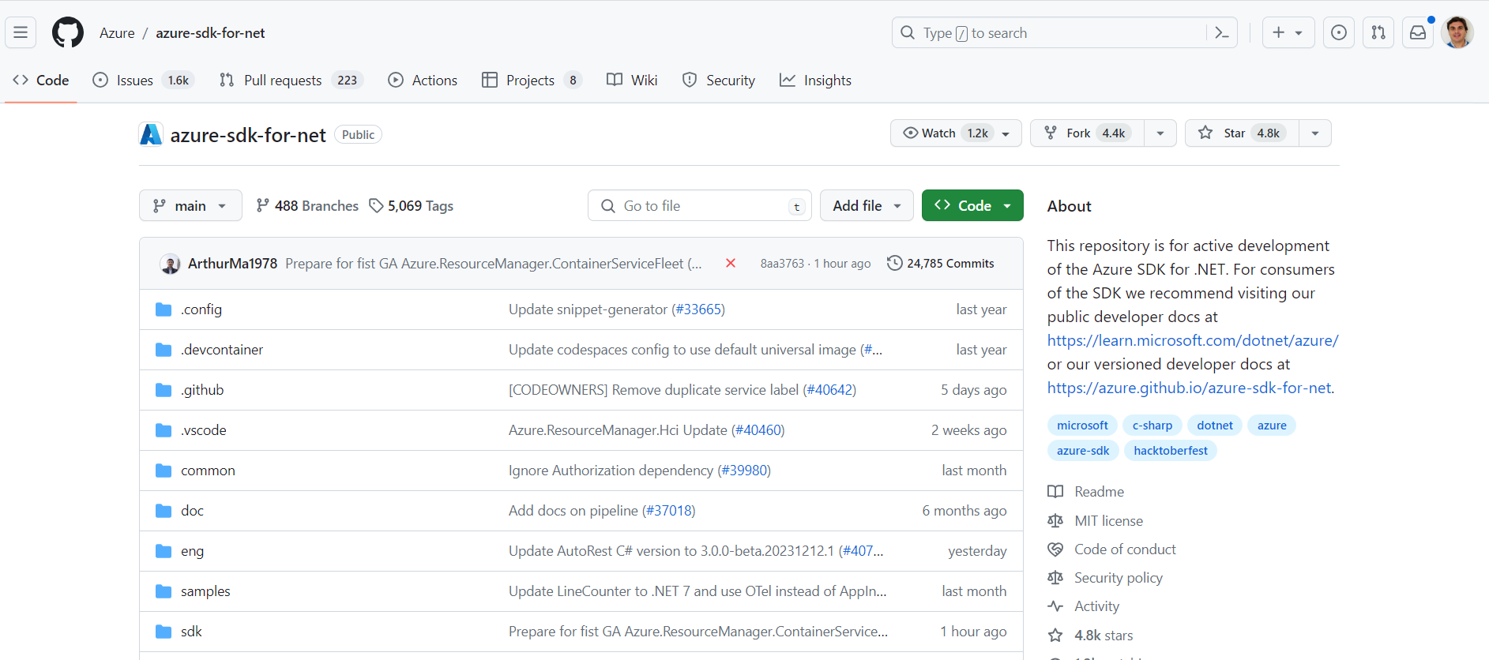
GitHub repositories
The Developer guide for the Azure SDK for .NET
https://github.com/Azure/azure-sdk-for-net

Slide 10
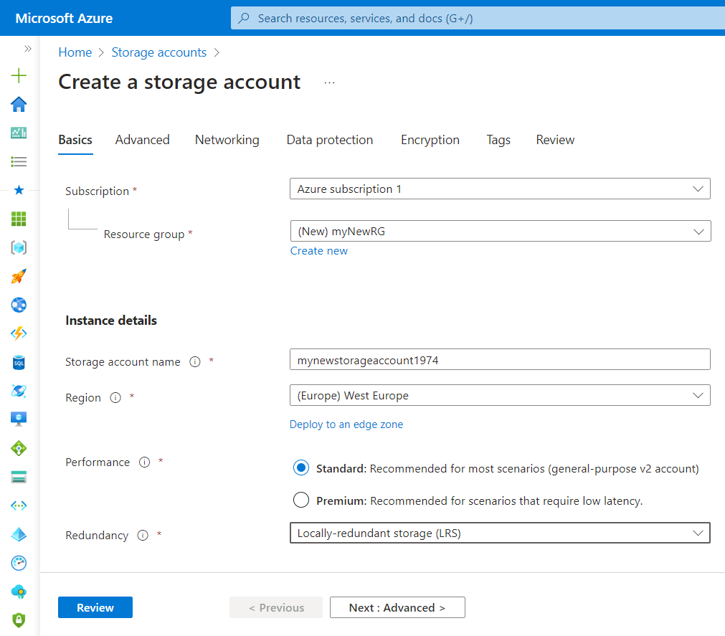
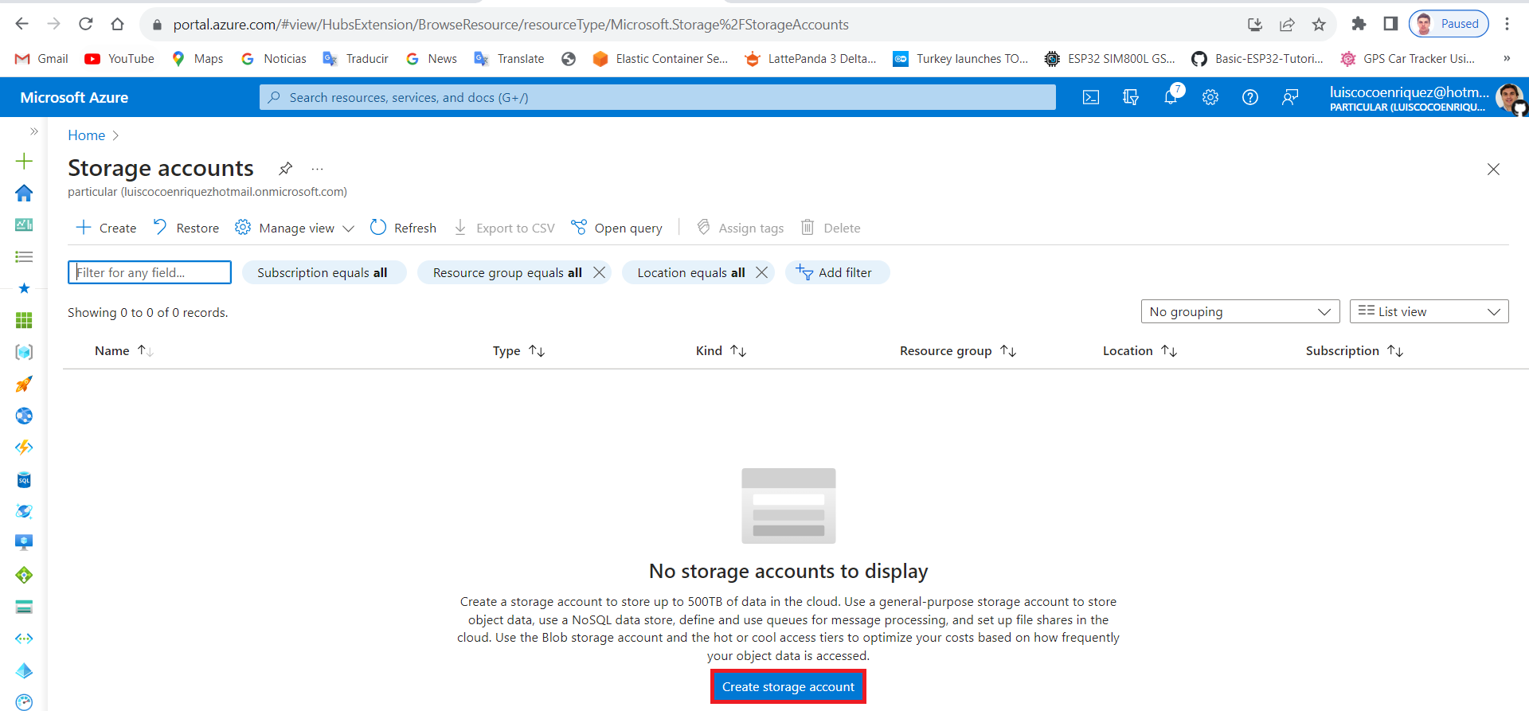
How to create a console application with VSCode
1. Create an Azure Storage account:
Input data: resource group, storage account name, region, redundancy.
https://learn.microsoft.com/en-us/azure/storage/blobs/storage-quickstart-blobs-dotnet

Slide 11
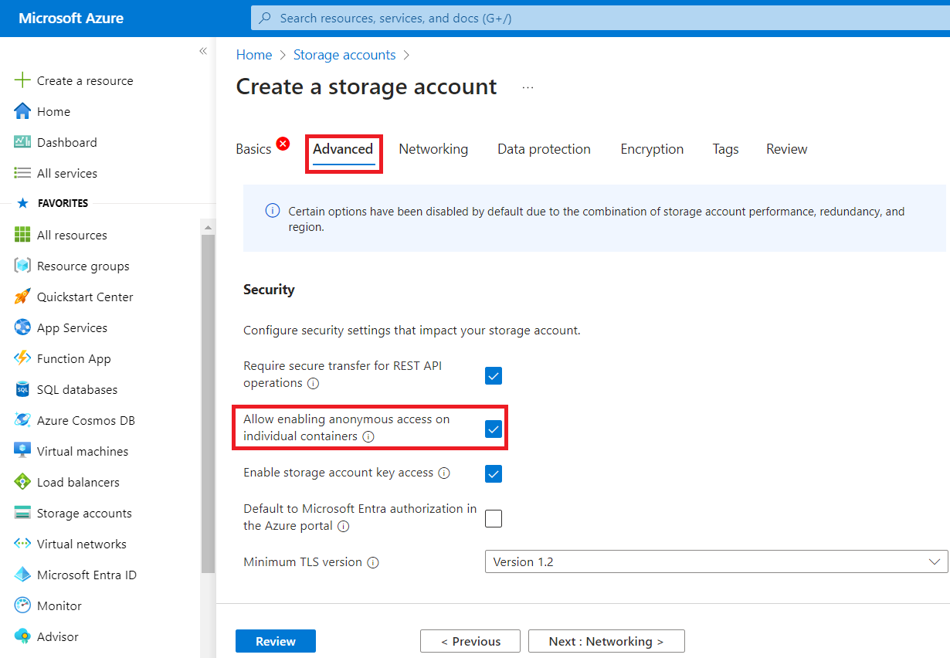
How to create a console application with VSCode
Allow enabling anonymous access on individual containers:
https://learn.microsoft.com/en-us/azure/storage/blobs/storage-quickstart-blobs-dotnet

Slide 12
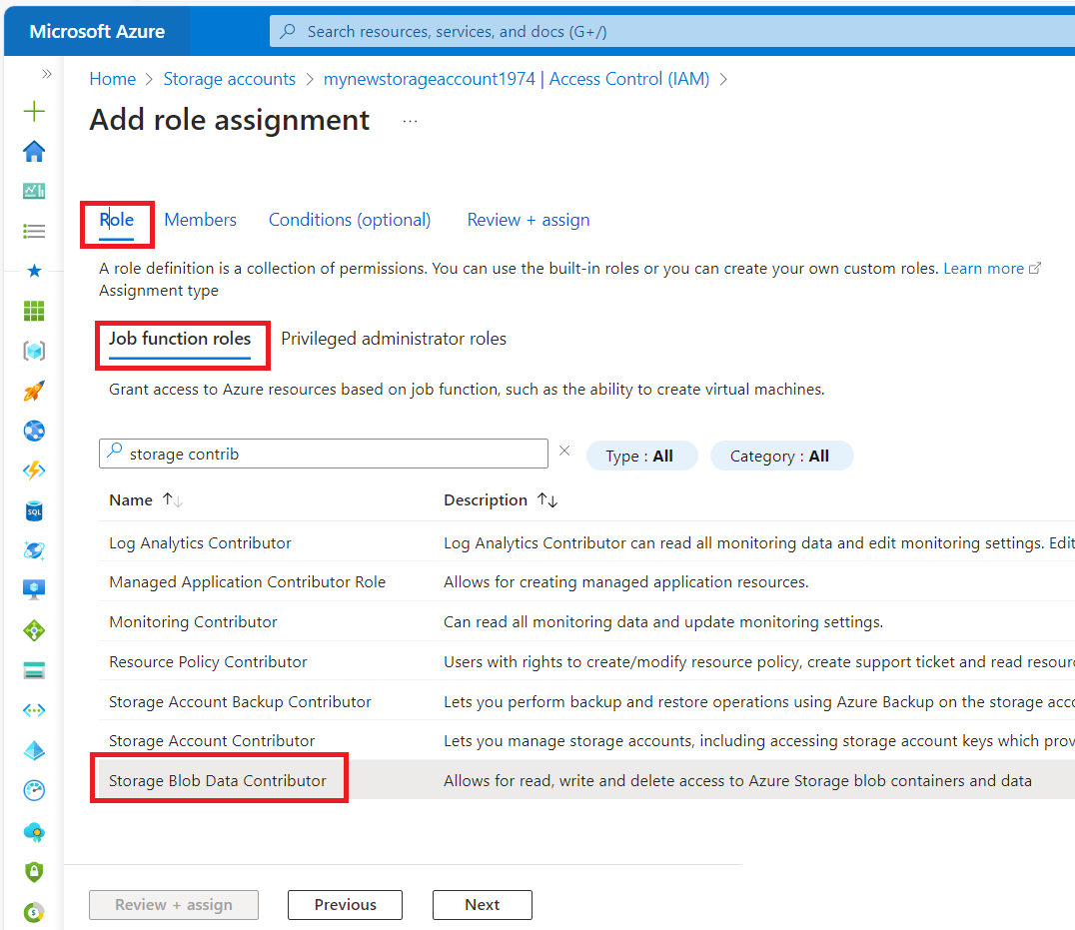
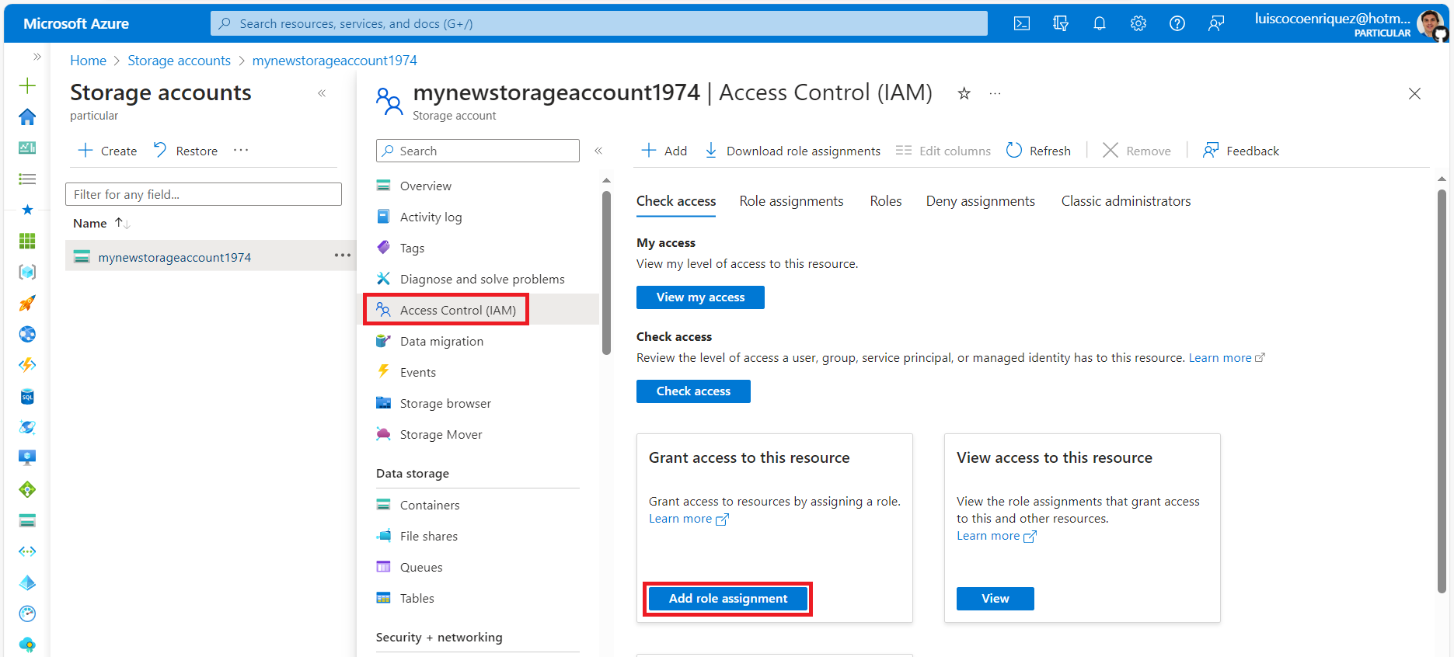
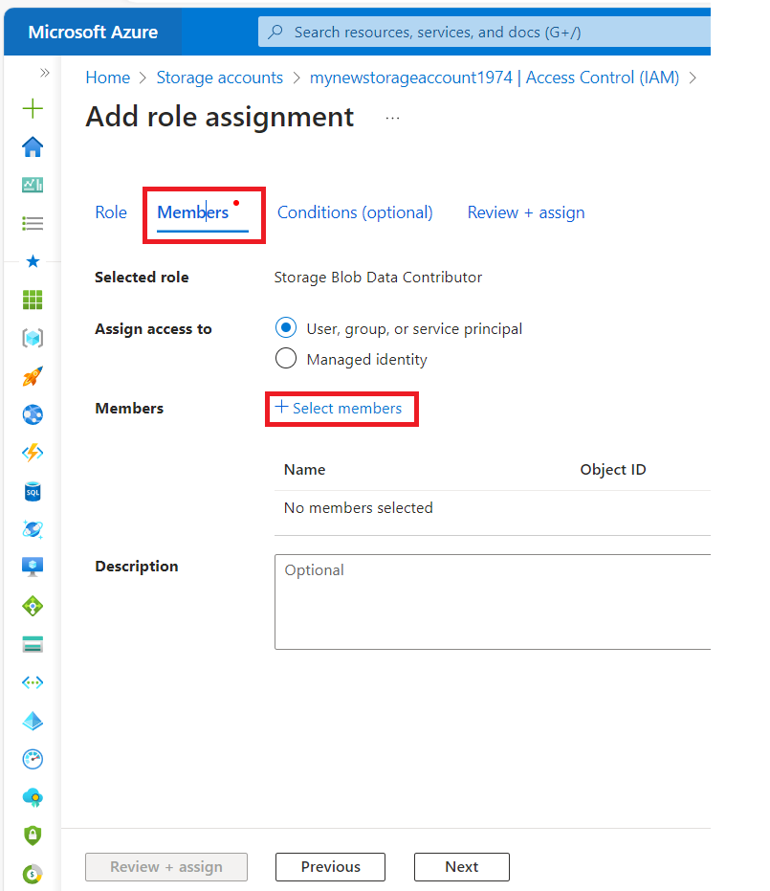
How to create a console application with VSCode
2. Grant permission for creating a Blob container:
Press the Access Control (IAM)
Press the “Add role assignment” button
Add Role: Storage Blob Data Contributor
Add Member: press select member and add the user

Slide 13
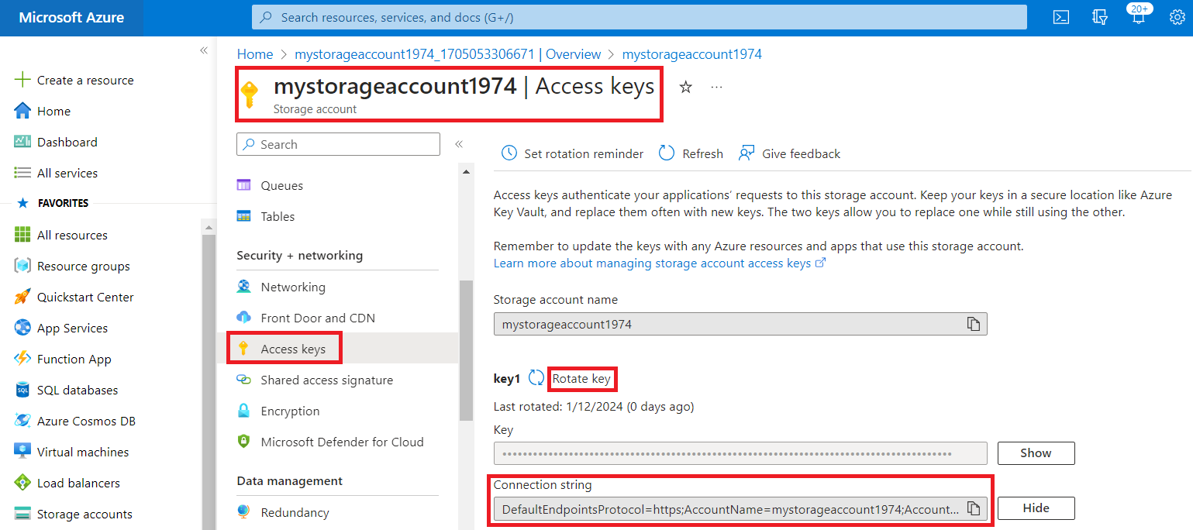
How to create a console application with VSCode
Copy the Azure Account Connection String
Note: if you get an error Rotate the Key
https://learn.microsoft.com/en-us/azure/storage/blobs/storage-quickstart-blobs-dotnet

Slide 14
C# code samples with Azure SDK for .NET
Sample 1: create a Blob container inside an Azure Storage account
using Azure.Storage.Blobs;
string connectionString = “<AzureStorageAccountConnectionString>";
string containerName = "data1";
BlobServiceClient blobServiceClient = new BlobServiceClient(connectionString);
BlobContainerClient container = await blobServiceClient.CreateBlobContainerAsync(containerName);
await container.SetAccessPolicyAsync(PublicAccessType.Blob);

Slide 15
C# code samples with Azure SDK for .NET
Sample 2: List blobs containers in an Azure Storage account
using Azure.Storage.Blobs;
using Azure.Storage.Blobs.Models;
string connectionString = "<AzureStorageAccountConnectionString>";
string containerName = "data";
BlobContainerClient blobContainerClient = new BlobContainerClient(connectionString, containerName);
await foreach(BlobItem blobItem in blobContainerClient.GetBlobsAsync())
{
Console.WriteLine("The Blob Name is {0}",blobItem.Name);
Console.WriteLine("The Blob Size is {0}", blobItem.Properties.ContentLength);
}

Slide 16
C# code samples with Azure SDK for .NET
Sample 3: Upload a file to a blob container
using Azure.Storage.Blobs;
using Azure.Storage.Blobs.Models;
string connectionString = “<AzureStorageAccountConnectionString>";
string containerName = "scripts";
string blobName = "script.sql";
string filePath = "C:\\tmp1\\script.sql";
BlobContainerClient blobServiceClient = new BlobContainerClient(connectionString, containerName);
BlobClient blobClient=blobServiceClient.GetBlobClient(blobName);
await blobClient.UploadAsync(filePath, true);
Console.WriteLine("Uploaded the blob");

Slide 17
Application Registration for Azure SDK for .NET
How to create a ResourceGroup (Application Registration)
Register the application in Microsoft Entra ID: Microsoft Entra ID->App registrations->Add
2. We copy the clientId and (optionally) you can also get from here the tenantId, we paste both values in the application variables clientId and tenantId
3. We create a new secret clicking on Client credentials link
4. We navigate in Azure Portal to the Subscriptions service and we copy the subscription subscriptionId
5. dotnet add package Microsoft.Rest.Azure.Authentication
6. string clientId = "XXX";
string clientSecret = "XXX";
string tenantId = "XXX";
string subscriptionId = "XXX";
string resourceGroupName = "myresourcegroupluiscocoenriquez";
string location = "westeurope";
var serviceClientCredentials = ApplicationTokenProvider.LoginSilentAsync(tenantId, clientId, clientSecret).Result;

Slide 18
DefaultAzureCredential() for Azure SDK for .NET
1. Login in Azure typing the command (previously install Azure CLI): az login
2. Create a C# console application with the command: dotnet new console --framework net8.0
3. Load the library “Azure.Identity” running the command: dotnet add package Azure.Identity --version 1.10.4
4. Load the library “Azure.Storage.Blobs” running the command:
dotnet add package Azure.Storage.Blobs --version 12.19.1
5. Input the C# application source code:
using Azure.Identity;
using Azure.Storage.Blobs;
var uri = new Uri("https://mynewstorageaccount1974.blob.core.windows.net/newblob/blob.txt");
var cred = new DefaultAzureCredential();
var client = new UploadAsyncBlobClient(uri, cred);
await client. ("blob.txt");
StorageAccountName
BlobConatinerName
BlobName

Slide 19
How to create a console application with VSCode
1. To install.NET CLI tools download the .NET 8 SDK: https://dotnet.microsoft.com/en-us/download
2. Open in VSCode a Terminal window and run the command: dotnet new console --framework net8.0
3. Load the Azure SDK for .NET libraries: https://www.nuget.org/packages
dotnet add package Azure.Identity --version 1.10.4
dotnet add package Azure.Storage.Blobs --version 12.19.1
Type the command dotnet restore and see the csproj file.
4. Input the source code in the program.cs file.
5. For building and running the application type the command: dotnet run
https://learn.microsoft.com/en-us/dotnet/core/tools/

Slide 20
How to create a console application with VSCode
using Azure.Storage.Blobs;
using Azure.Storage.Blobs.Models;
using Azure.Identity;
// TODO: Replace <storage-account-name> with your actual storage account name
var blobServiceClient = new BlobServiceClient(
new Uri("https://<storage-account-name>.blob.core.windows.net"),
new DefaultAzureCredential());
//Create a unique name for the container
string containerName = "quickstartblobs" + Guid.NewGuid().ToString();
// Create the container and return a container client object
BlobContainerClient containerClient = await blobServiceClient.CreateBlobContainerAsync(containerName);
// Create a local file in the ./data/ directory for uploading and downloading
string localPath = "data";
Directory.CreateDirectory(localPath);
string fileName = "quickstart" + Guid.NewGuid().ToString() + ".txt";
string localFilePath = Path.Combine(localPath, fileName);
// Write text to the file
await File.WriteAllTextAsync(localFilePath, "Hello, World!");
// Get a reference to a blob
BlobClient blobClient = containerClient.GetBlobClient(fileName);
Console.WriteLine("Uploading to Blob storage as blob:\n\t {0}\n", blobClient.Uri);

Slide 21
How to create a console application with VSCode
// Upload data from the local file
await blobClient.UploadAsync(localFilePath, true);
Console.WriteLine("Listing blobs...");
// List all blobs in the container
await foreach (BlobItem blobItem in containerClient.GetBlobsAsync()) {
Console.WriteLine("\t" + blobItem.Name);
}
// Download the blob to a local file. Append the string "DOWNLOADED" before the .txt extension
string downloadFilePath = localFilePath.Replace(".txt", "DOWNLOADED.txt");
Console.WriteLine("\nDownloading blob to\n\t{0}\n", downloadFilePath);
// Download the blob's contents and save it to a file
await blobClient.DownloadToAsync(downloadFilePath);
// Clean up
Console.Write("Press any key to begin clean up");
Console.ReadLine();
Console.WriteLine("Deleting blob container...");
await containerClient.DeleteAsync();
Console.WriteLine("Deleting the local source and downloaded files...");
File.Delete(localFilePath);
File.Delete(downloadFilePath);
Console.WriteLine("Done");

Slide 22
C# code samples with Azure SDK for .NET
Sample 1: How to use DefaultAzureCredential() for uploading a file to an Azure Blob container
Sample 2: How to create an Azure Storage Account
Sample 3: Azure Storage Account operations
Sample 4: How to create an Azure Resource Group
Sample 5: How to create a Blob storage
Sample 6: How to create a FileShare
Sample 7: Accessing with a Storage Account Key
Sample 8: How to create a Blob and Upload a file
Sample 9: Create a Blob, Upload/Donwload a File (accessing with storage account connection-string)
Sample 10: Create a SAS for a Blob

Slide 23
C# code samples with Azure SDK for .NET
Sample 11: How to create a Virtual Network
Sample 12: How to create a Network Interface NIC
Sample 13: How to create a Linux VM and install GUI Desktop
Sample 14: How to create a Windows Server VM with Visual Studio 2022 preinstalled
Sample 15: List the VMs in a ResourceGroup
Sample 16: Delete VM in a ResourceGroup
Sample 17: How to create a Disk in Azure
Sample 18: List the Disks in a ResourceGroup
Sample 19: Delete a Disk in a ResourceGroup
Sample 20: Create a Secret in a Key Vault

Slide 24
C# code samples with Azure SDK for .NET
Sample 21: How to create an Azure CosmosDB account
Sample 22: How to create an Azure CosmosDB database, a collection and populate it with some documents
Sample 23: Create a CosmosDB database
Sample 24: Create a CosmosDB collection
Sample 25: Create a Cosmos DB for MongoDB and insert some documents
Sample 26: Create an Azure Container Registry (ACR) and deploy with Azure CLI a .NET Web API in Azure ACI
Sample 27: How to create a ResourceGroup (Application Registration)
Sample 28: GithubActions How to create from Github an Azure ResourceGroup with Azure SDK for .NET
Sample 29: How to create Azure ResourceGroup from Azure Function
Sample 30: How to create Azure App Service Plan and Azure Web App with Azure SDK for .NET
Sample 31: How to create a .NET8 WebAPI CRUD Azure CosmosDB for MongoDB Microservice
Sample 32: How to create a .NET8 WebAPI CRUD Azure CosmosDB Microservice

